Slide 1
Поиск в условиях противодействия
(Игры)
Notes:
24/02

Slide 2
Game definition
A game can be formally defined as a kind of search problem with the following elements:
S0: The initial state, which specifies how the game is set up at the start.
PLAYER(s): Defines which player has the move in a state.
ACTIONS(s): Returns the set of legal moves in a state.
RESULT(s, a): The transition model, which defines the result of a move.
TERMINAL-TEST(s): A terminal test, which is true when the game is over and false otherwise. States where the game has ended are called terminal states.
UTILITY(s, p): A utility function (also called an objective function or payoff function), defines the final numeric value for a game that ends in terminal state s for a player p. A zero-sum game is defined as one where the total payoff to all players is the same for every instance of the game.

Slide 3

Game tree (2-player, deterministic, turns)

Slide 4

Minimax
Perfect play for deterministic games
Idea: choose move to position with highest minimax value
= best achievable payoff against best play
E.g., 2-ply game:

Slide 5

Minimax algorithm

Slide 6
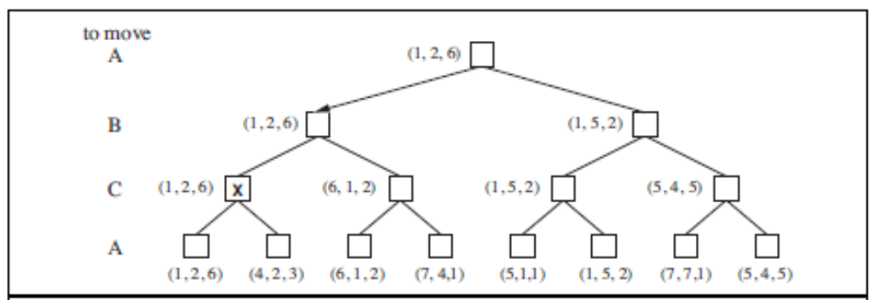
Optimal decisions in multiplayer games

Slide 7
Properties of minimax
Complete? Yes (if tree is finite)
Optimal? Yes (against an optimal opponent)
Time complexity? O(b^{m})
Space complexity? O(bm) (depth-first exploration)
For chess, b ≈ 35, m ≈100 for "reasonable" games
→ exact solution completely infeasible
Notes:
26.10

Slide 8

α-β pruning example

Slide 9

α-β pruning example

Slide 10

α-β pruning example

Slide 11

α-β pruning example

Slide 12

α-β pruning example

Slide 13
Properties of α-β
Pruning does not affect final result
Good move ordering improves effectiveness of pruning
With "perfect ordering" time complexity = O(b^{m/2})
  → doubles depth of search

Slide 14

Why is it called α-β?
α is the value of the best (i.e., highest-value) choice found so far at any choice point along the path for max
If v is worse than α, max will avoid it
  → prune that branch
Define β similarly for min

Slide 15
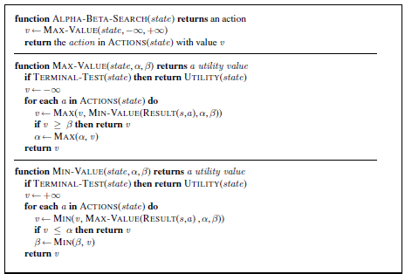
The α-β algorithm

Slide 16
Evaluation functions
For chess, typically linear weighted sum of features
Eval(s) = w₁ f₁(s) + w₂ f₂(s) + … + w_{n} f_{n}(s)
e.g., w₁ = 9 with
f₁(s) = (number of white queens) – (number of black queens), etc.
Notes:
23.10

